Slide 1
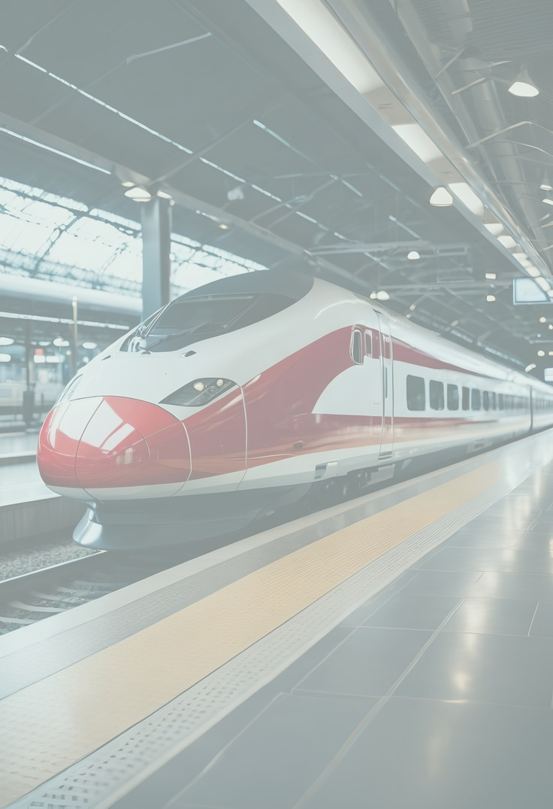



UK TRAIN RIDES
Data Rangers
| Get a glimpse of our goal-crushing process
01/11
Team
28/11
Abdelrahman Elsaid Abdelrazek Alshaal
Ahmed Mahmoud Haneen Shahien
Lama Diaa Osama Mohamed

Slide 2
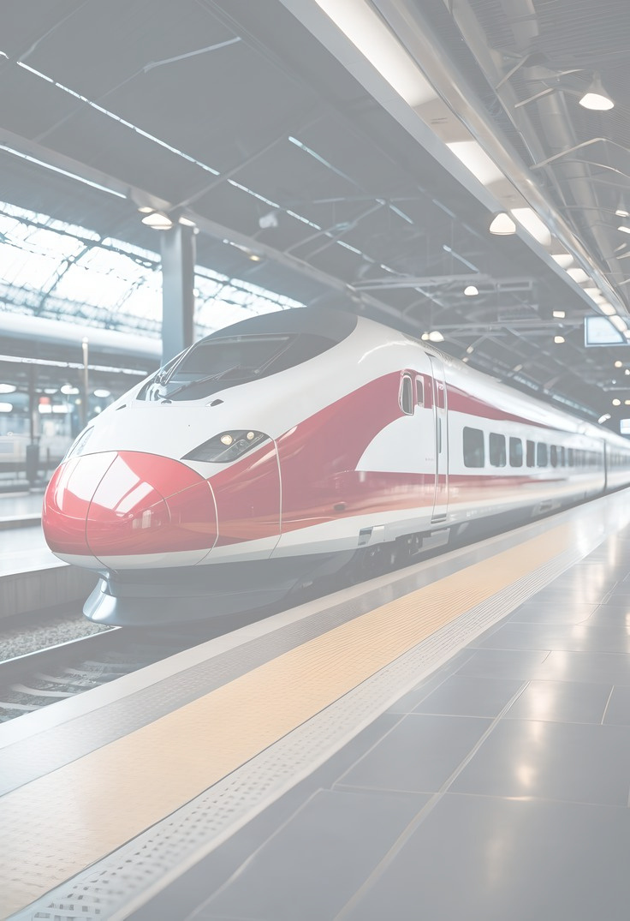

Quick Look
1
5
Introduction
Data Exploration
2
6
Questions to answer
Problem
3
7
Objective
Dashboad
4
8
Piplines
Conclusion

Slide 3
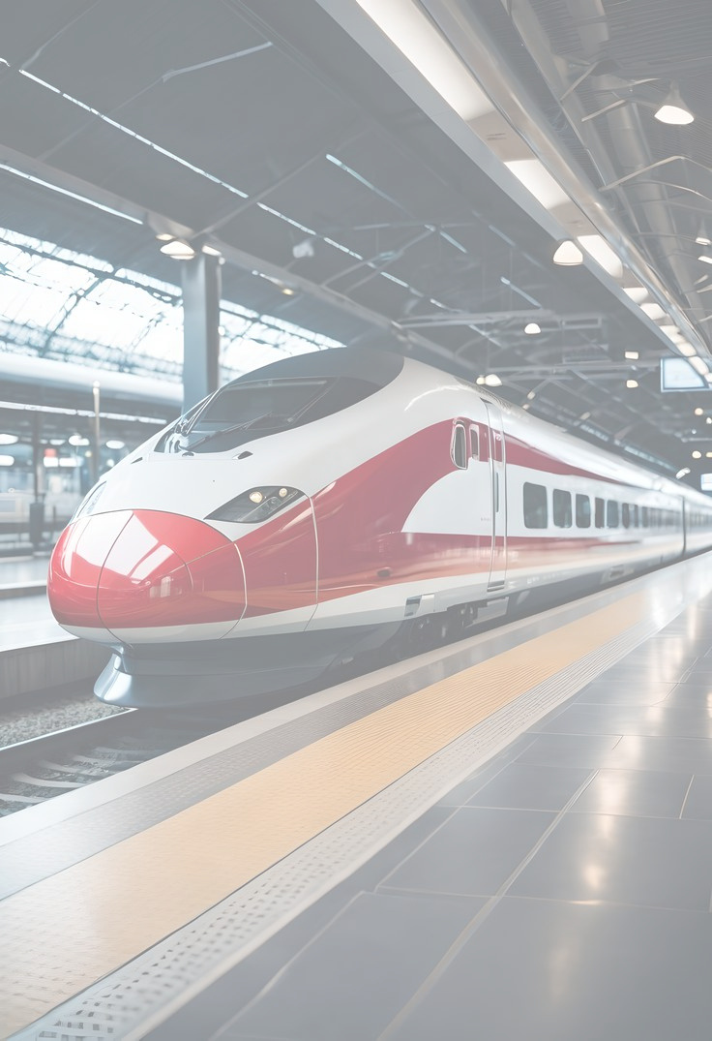
INTRODUCTION
In the UK, more than a million train journeys happen every single day — each one carrying a story of movement, timing, and sometimes… delays.
Our project explores these journeys from the moment a ticket is purchased until the passenger reaches their destination

Slide 4

INTRODUCTION
By analyzing patterns in delays, ticket types, travel times, payment methods, and more, we uncover what truly shapes the experience of a UK train ride.
This analysis helps us understand not just how people travel — but why certain journeys go smoothly while others don’t.

Slide 5


PROBLEM
UK train journeys often face delays, inconsistent ticket prices, and varied passenger experiences, but the reasons behind these issues aren’t always clear.

Slide 6




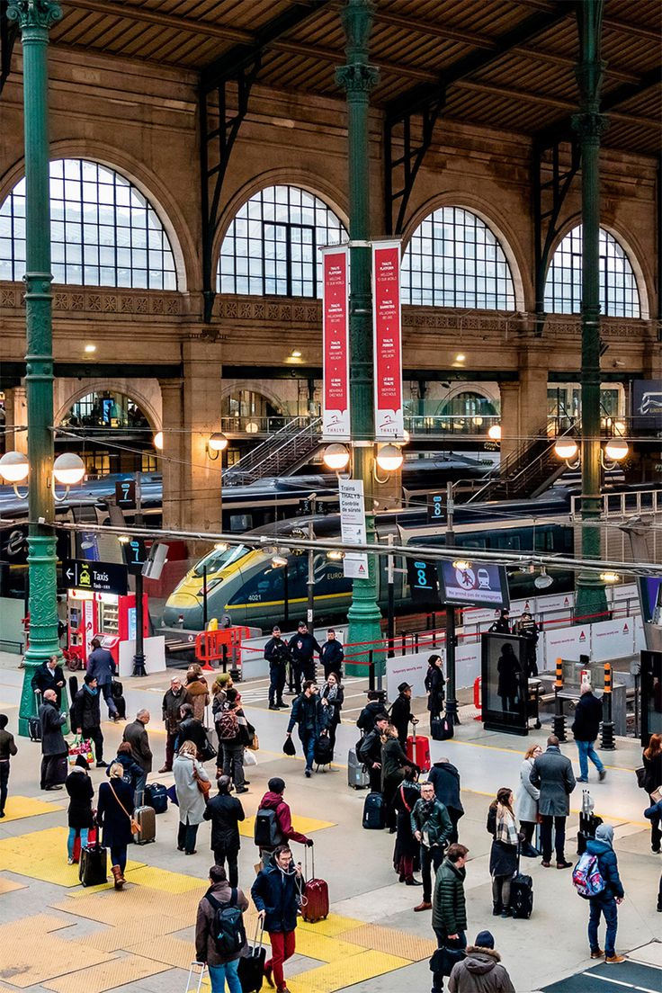
OUR
Identify the key factors causing train delays using journey status, arrival time, and peak vs. off-peak patterns.
OBJECTIVES
Analyze passenger behavior through railcard usage, ticket type, ticket class, and payment methods.
Understand booking patterns by studying time of purchase, date of purchase, and day/month trends

Slide 7
OUR
Evaluate station performance by comparing departure and arrival stations and their delay patterns
OBJECTIVES
Assess pricing variations across routes, ticket types, and seasons to identify cost patterns.
Provide data-driven insights that can help improve service reliability, reduce delays, and enhance passenger experience.

Slide 8



PIPLINES
1
2
3
Data cleaning
4
EDA
FORECASTING
Final Insights

Slide 9


The dataset contains detailed records of UK train journeys, including ticket, payment, and journey information.
It covers both time-based details (departure, arrival) and transactional data (price, ticket type, railcard usage).
31653 x 22
Additional features capture journey outcomes like delays, refunds, and status for comprehensive analysis.
DATA DESCRIPTION

Slide 10

MISSING VALUES
Missing values in Railcard exist because 66% of passengers did not use a discount.
Missing Actual Arrival Time appears only in cancelled journeys, so these values are expected.
Reason for Delay is missing for journeys that were not delayed, which is normal.
DATA ISSUES

Slide 11

OUTLIERS
DATA ISSUES
Most train tickets are inexpensive (between £5 and £35), and the median price is only £11.
However, the price distribution is highly skewed due to a relatively small number of premium tickets reaching up to £267.

Slide 12
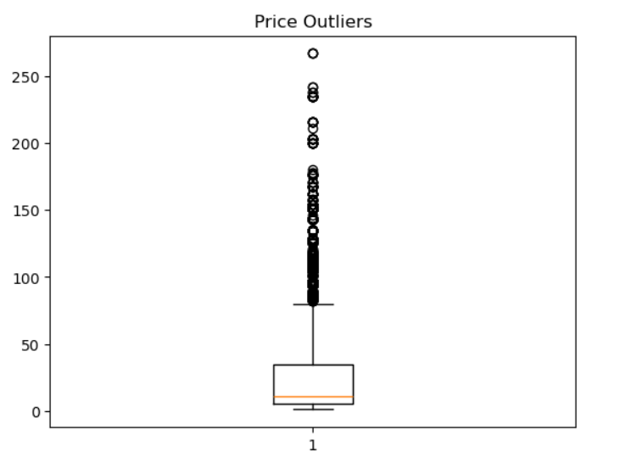



5 % OF JOURNEYS
( 1555 OF 30535 )
OUTLIERS
Any price above £80 is considered an outlier based on the IQR method.
153
Standard ticket
With Railcard
Long distance trips
1402
ticket
No railcard
First class ticket
Long distance

Slide 13
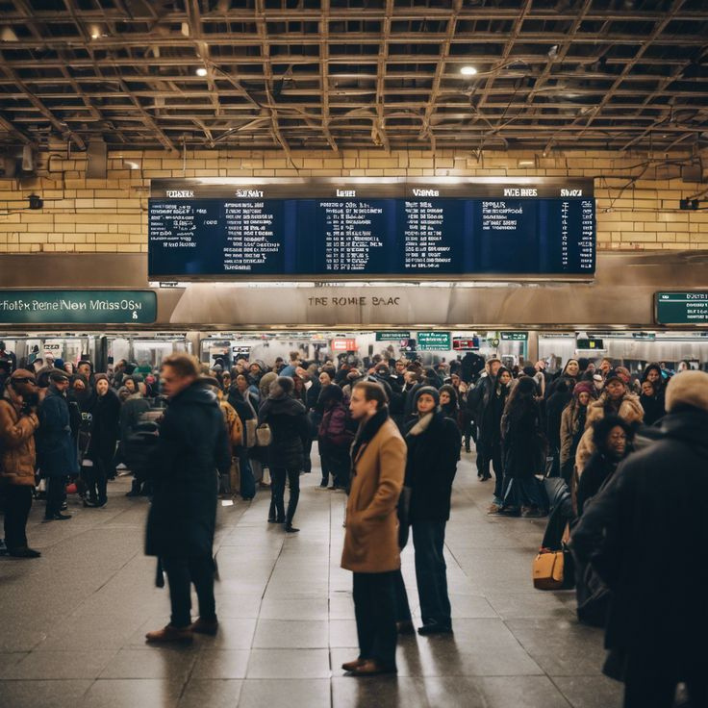
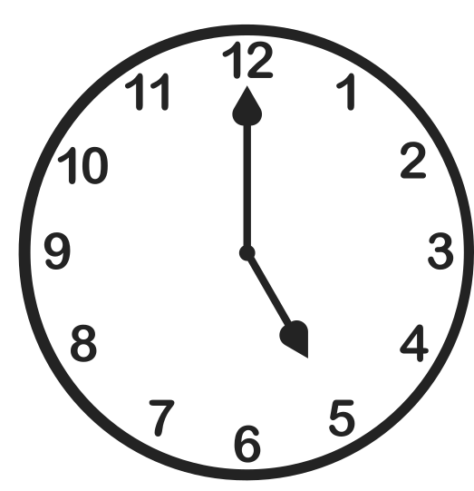

PEAK HOUR ANALYSIS
Most trips occur at 5 PM
Indicates evening rush hour for travelers

Slide 14



Handling missing values
No Duplicates
Feature Extraction
DATA PREPROCESSING

Slide 15


QUESTIONS THAT SPARKED OUR CURIOSITY

Slide 16
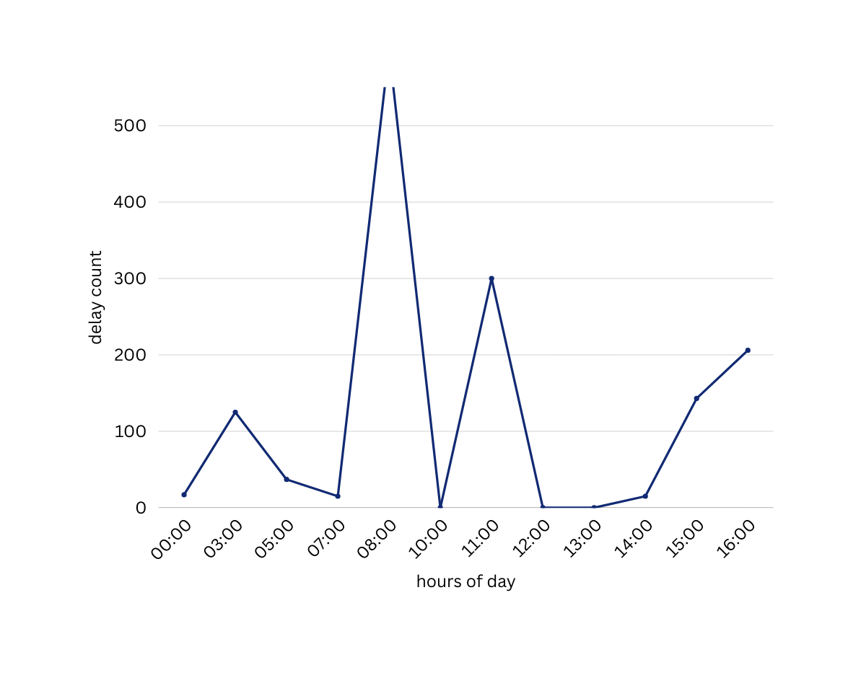
Is there a time of day when delays spike?
“ 8 AM shows the sharpest rise in delays, highlighting a key window for operational improvements.”

Slide 17
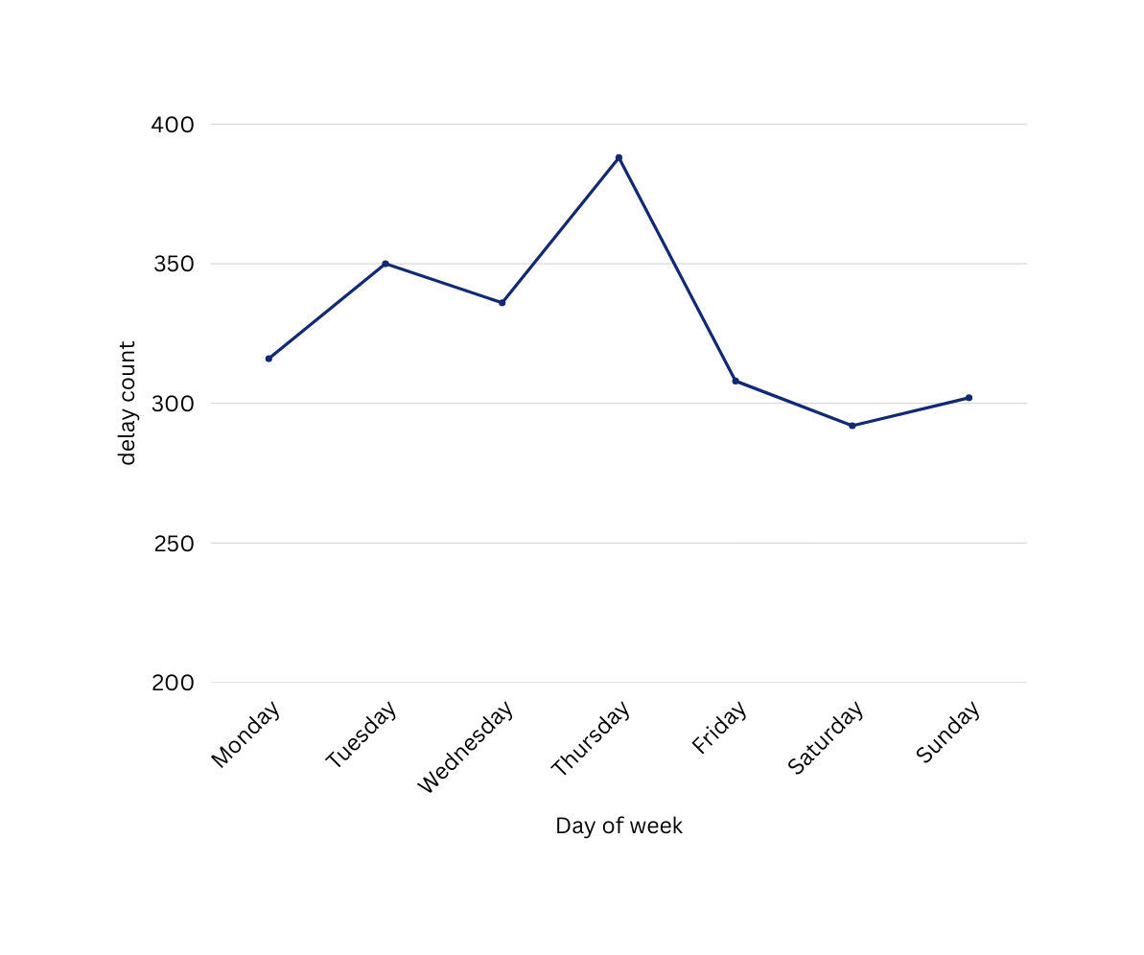
Is there a day of the week when delays spike?
“Thursday shows the highest spike in delays (388), indicating increased operational pressure at the end of the work week.”

Slide 18
 | Trips | Delay rate | AVG delay min
Standard class | 28595 | 7.19 | 42
First Class | 3058 | 7.68 | 42
Do First Class tickets get faster and more reliable service ?
“Despite expectations, First Class does not receive faster or more reliable service.
This indicates that service reliability is consistent across all ticket classes, regardless of price.”

Slide 19
What was the cause of the high refund rates?
Liverpool Lime Street → London Euston
The top 5 highest refund counts are all due to Weather Conditions
Most refund cases are caused by Technical Issues and Signal Failures
appears multiple times in the top refund list with different causes indicating a consistently problematic route that needs priority intervention.

Slide 20

What percentage of delayed trips actually lead to refund requests?
23.82%

Slide 21


Refund revenue rate
67.61%
32.39%
Refund revenue from delay rate
Refund revenue from cancel rate

Slide 22

03.
Dashboard

Slide 23
BEFORE DASHBOARD
1
2
3
Extracted new features (day, month, delay duration).
Detected outliers related to long-distance premium trip
Data cleaned & enriched

Slide 24
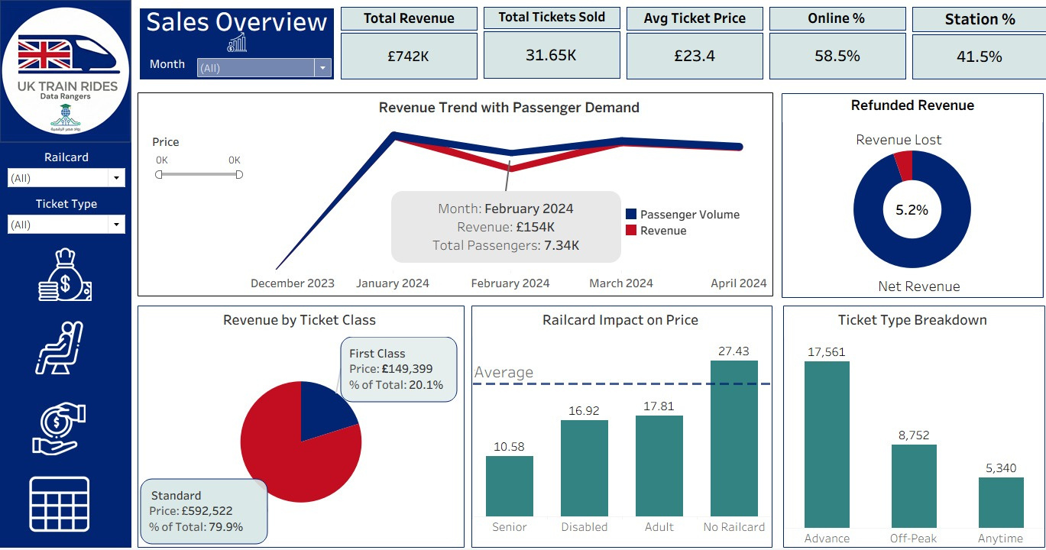

Slide 25
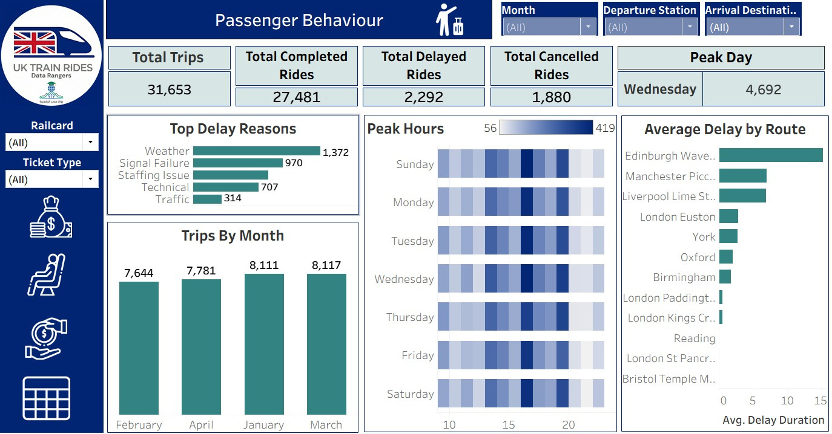

Slide 26
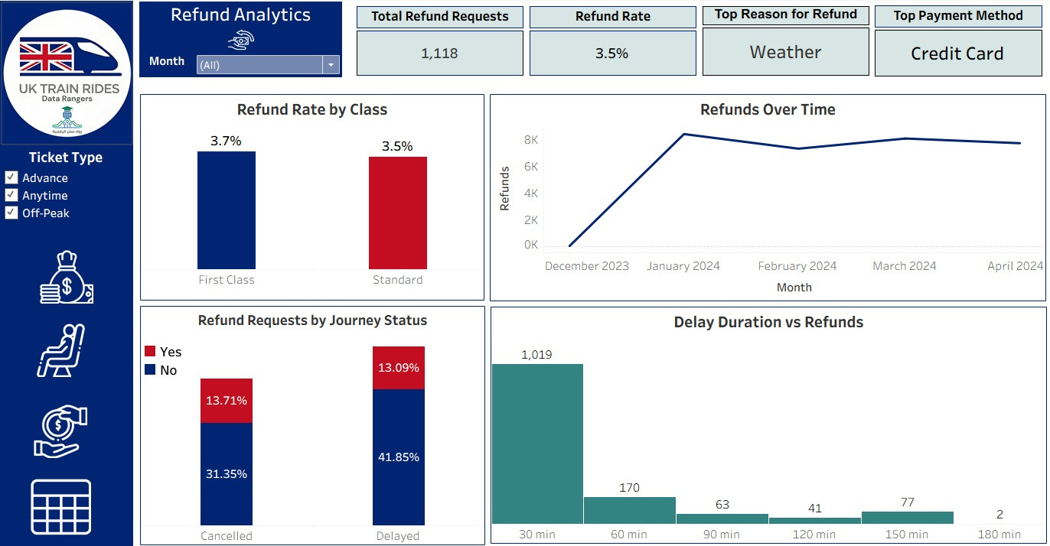

Slide 27
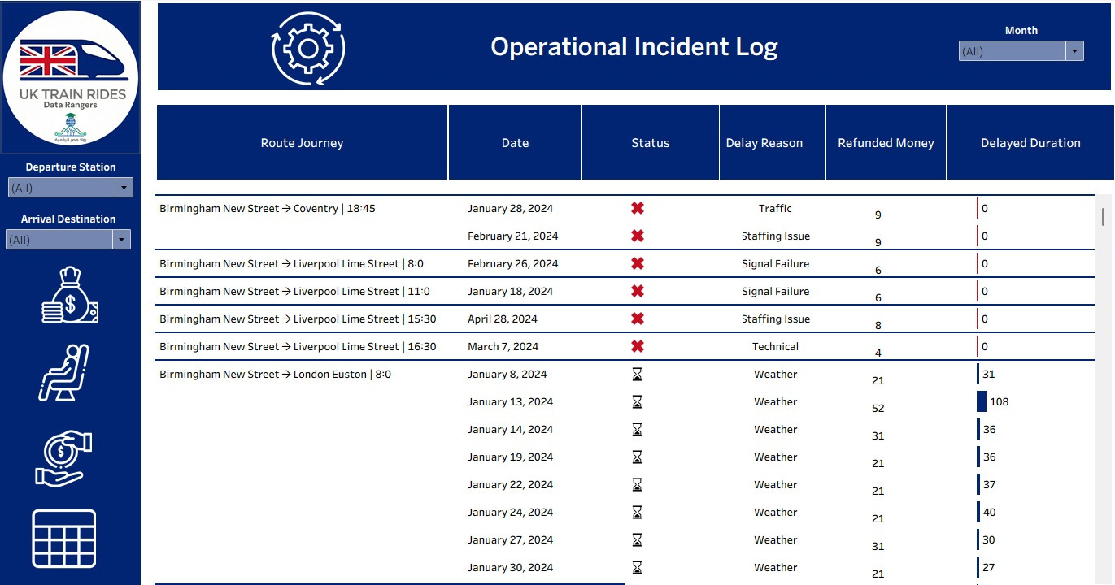

Slide 28
04.
RESULTS

Slide 29


Around 80% of revenue comes from Standard tickets, yet First Class contributes a notable 20%, suggesting a profitable segment of passengers willing to pay more for premium services.
Sales
Schedule
Passenger demand peaks mid-week and at 5 PM, indicating strong reliance on trains for after-work commuting rather than leisure travel.
Passengers with railcards pay far less (less than half the price of non-railcard users), but the discount leads to higher ticket sales overall, showing that railcards are effective for driving demand.
Railcards
More than 58% of tickets are booked online versus 41% at stations, emphasizing the importance of improving the digital booking experience to support growing customer behavior trends.
Booking
Implement a 100% no-fee refund policy for customers who requests refund for their tickets due to company-controlled operational failures (e.g., significant delays or technical issues).
Refund Policy

Slide 30



